Slide 1



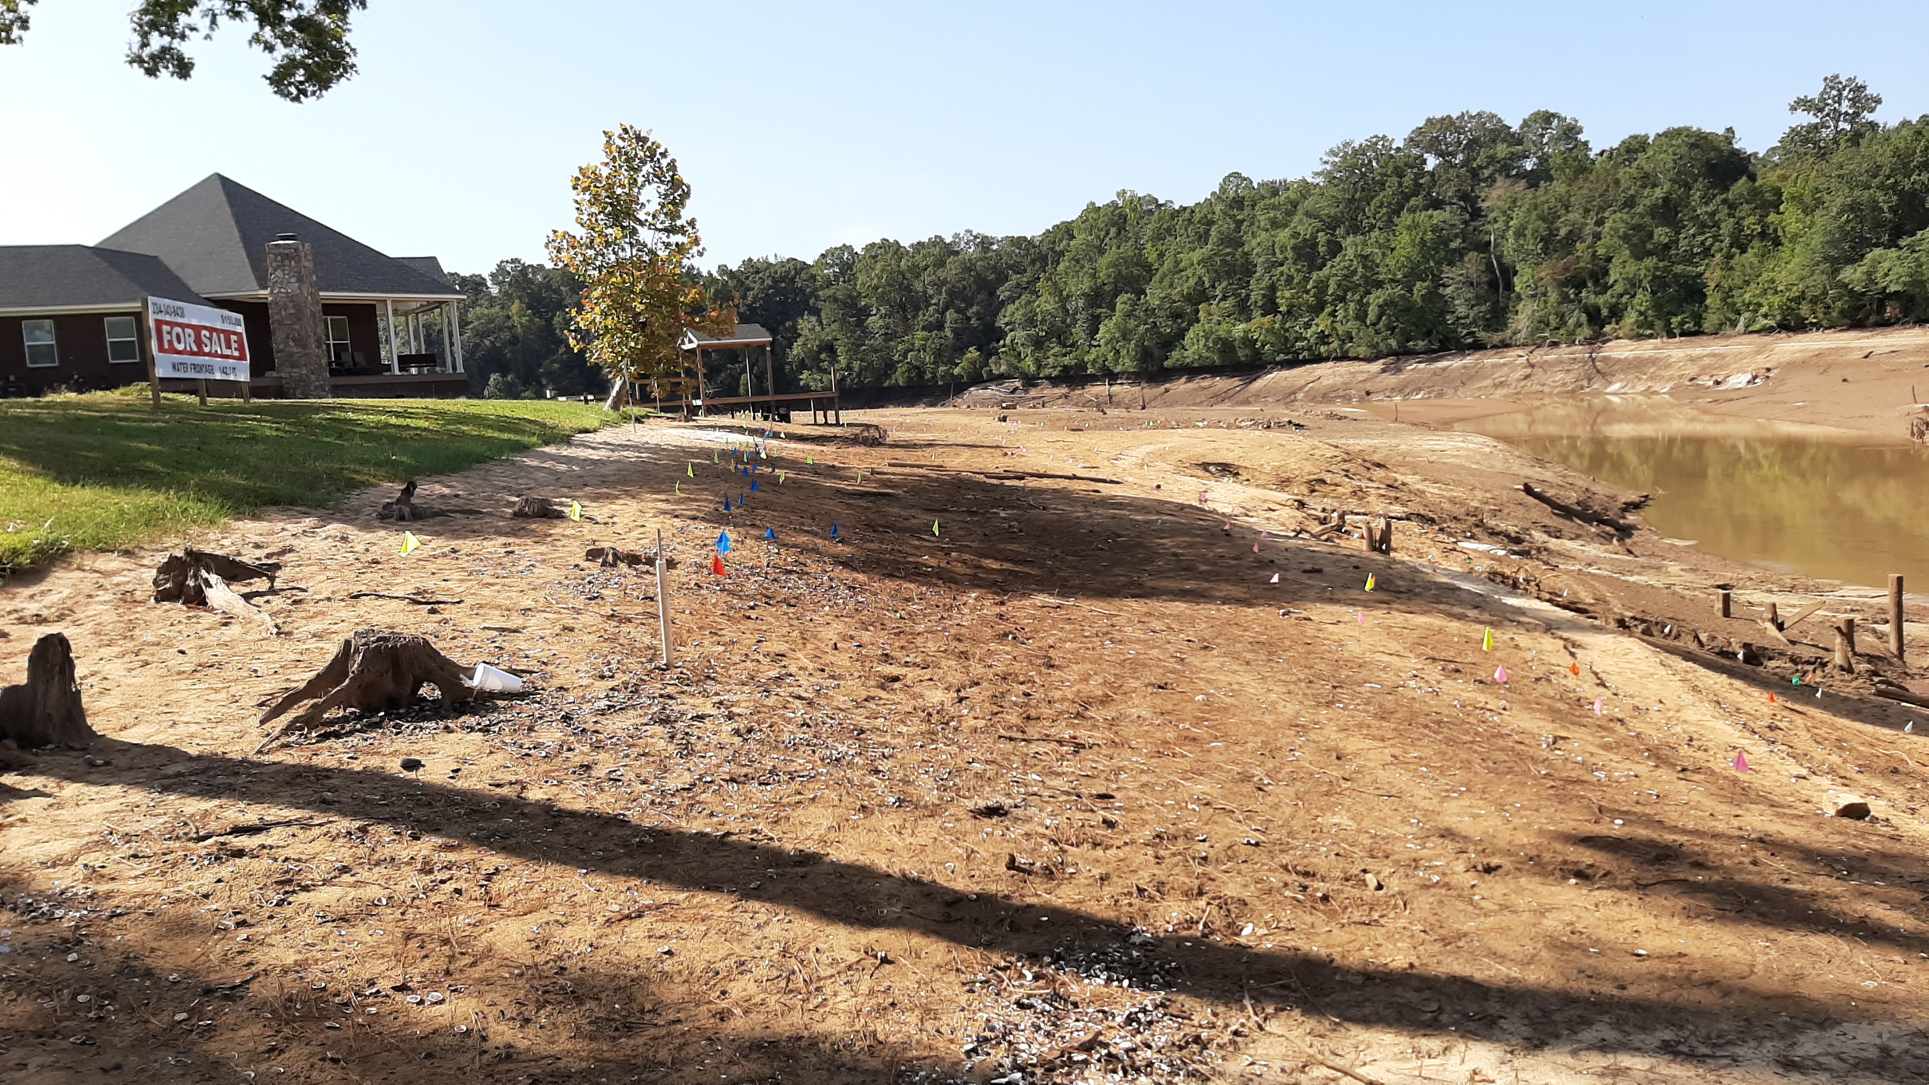
Tracking Movement of a Federally Threatened Species of Mussel During the Drawdown of Gantt Reservoir
Nguyen Tien Anh Quach, Jonathan M. Miller, Alban Guillaumet & Meet Patel

Slide 2

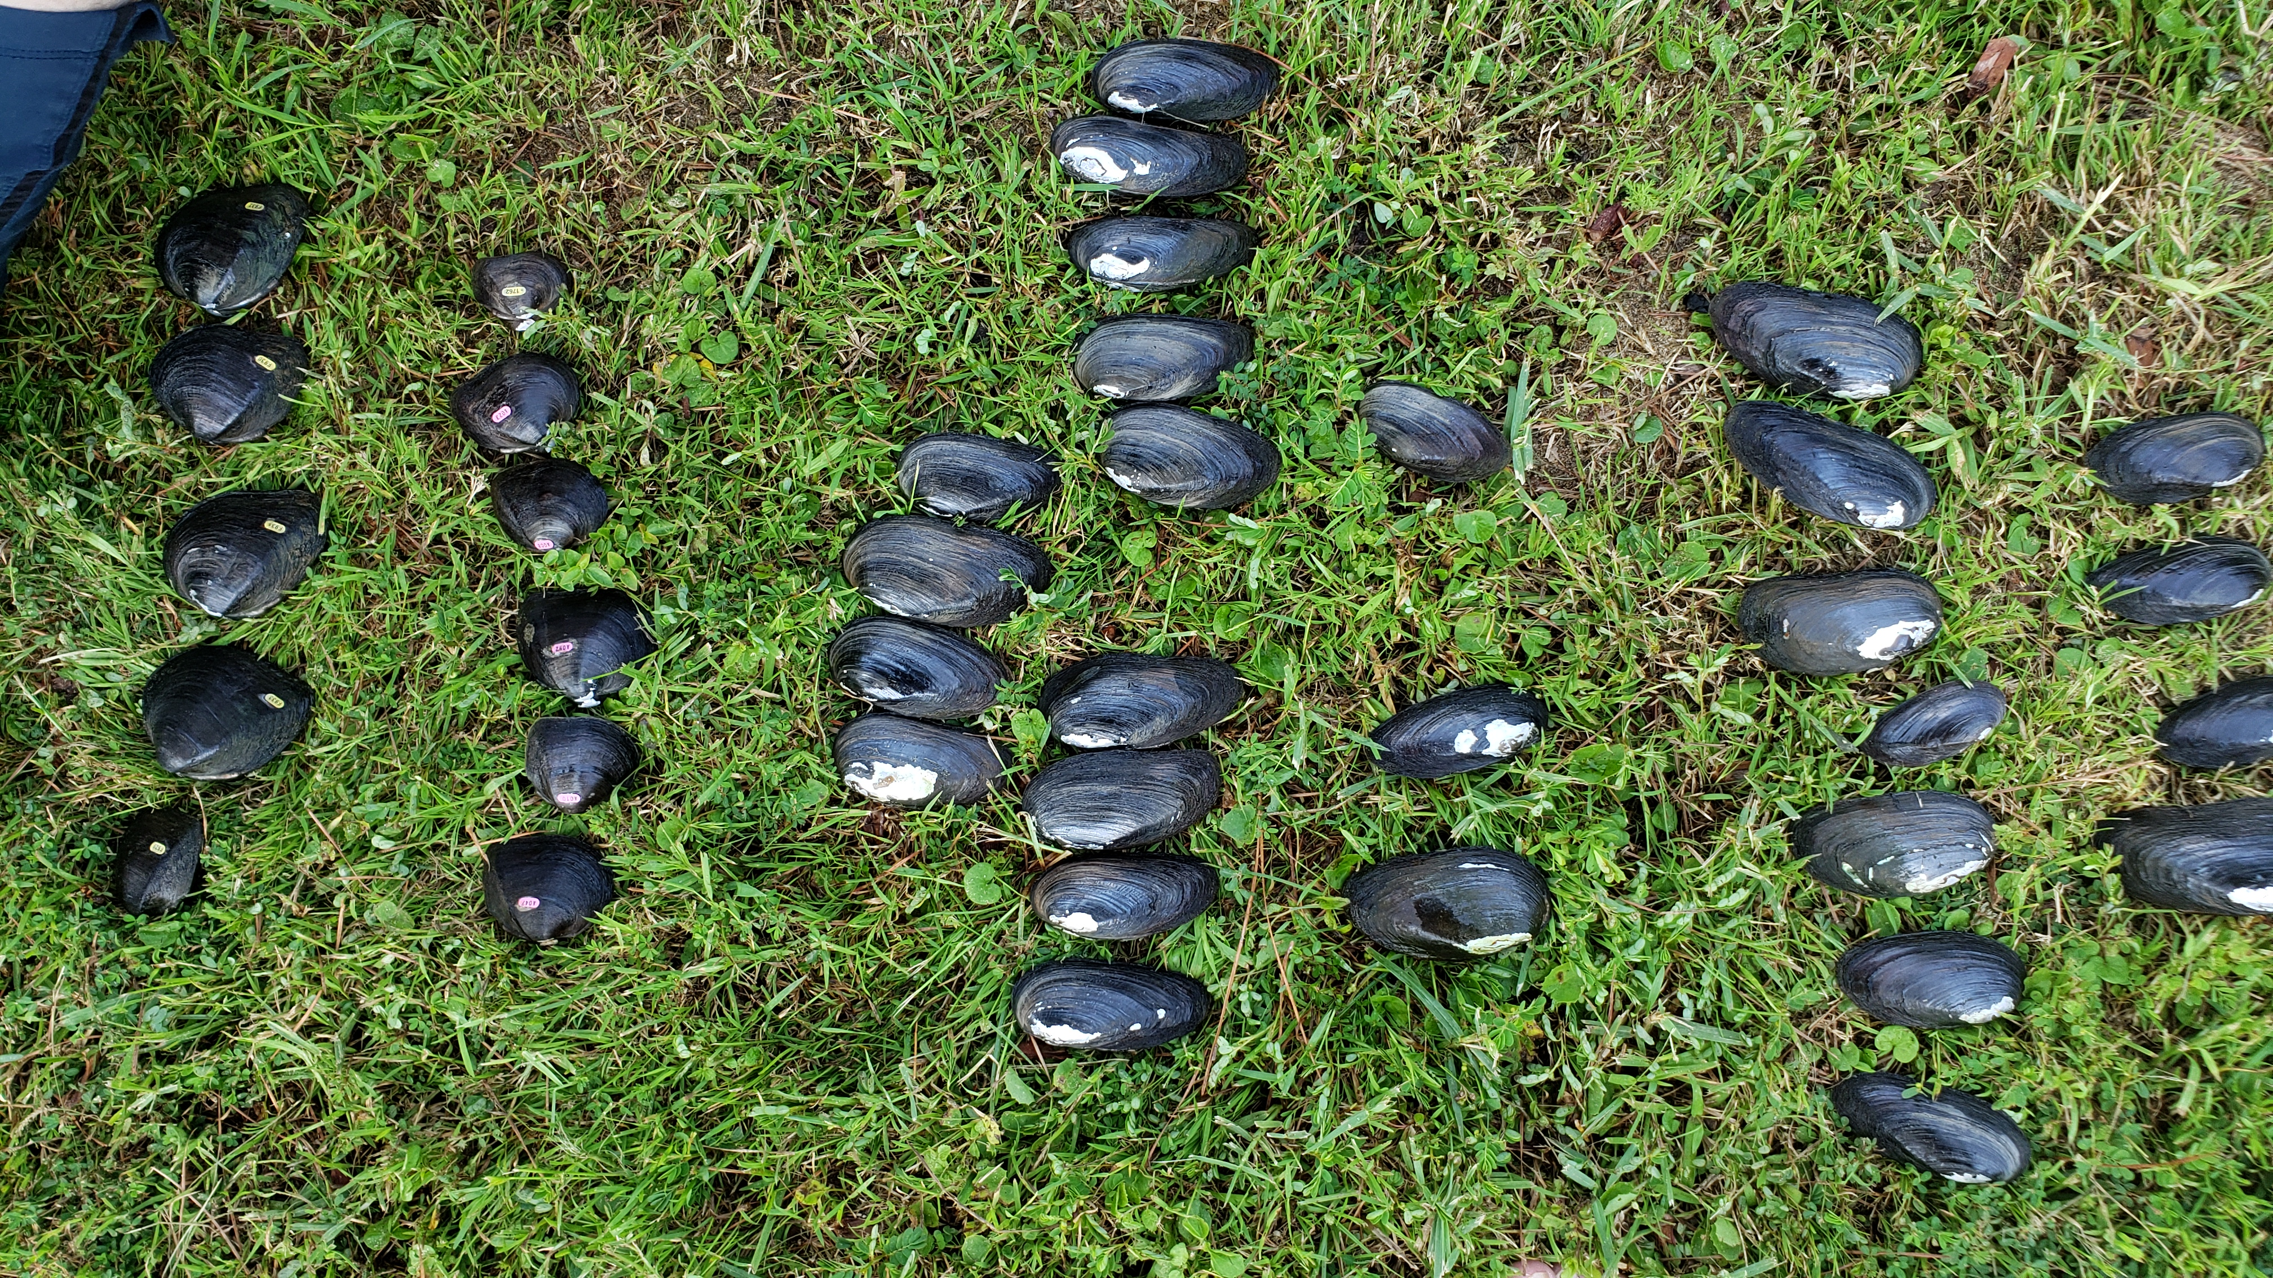
Introduction
Drawdown initiated several studies
Summer surveys
Isotope analysis
Survivability
Tracking movement
Notes:
As Mr. Robertson was talking about, the drawdown of Gantt Reservoir was planned to take place in September, which initiated …. isotope analysis, where Dr. Helms, who cannot make it to this meeting, is looking at C and N signature of mussels to determine the C source from parental material and where they are in the food chain.

Slide 3
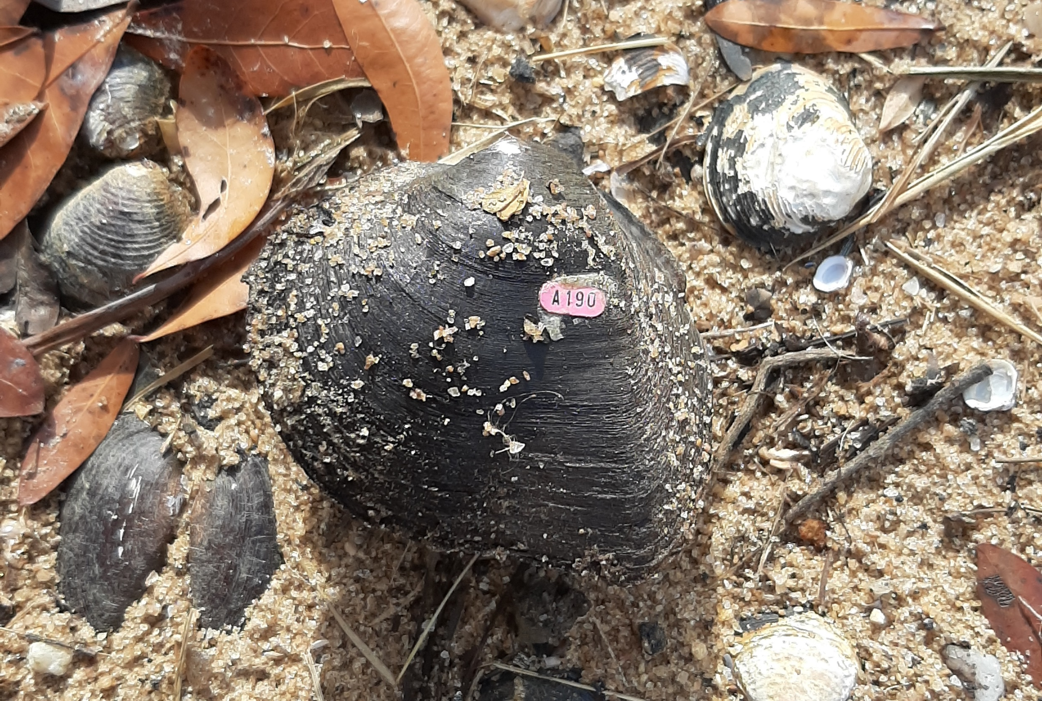
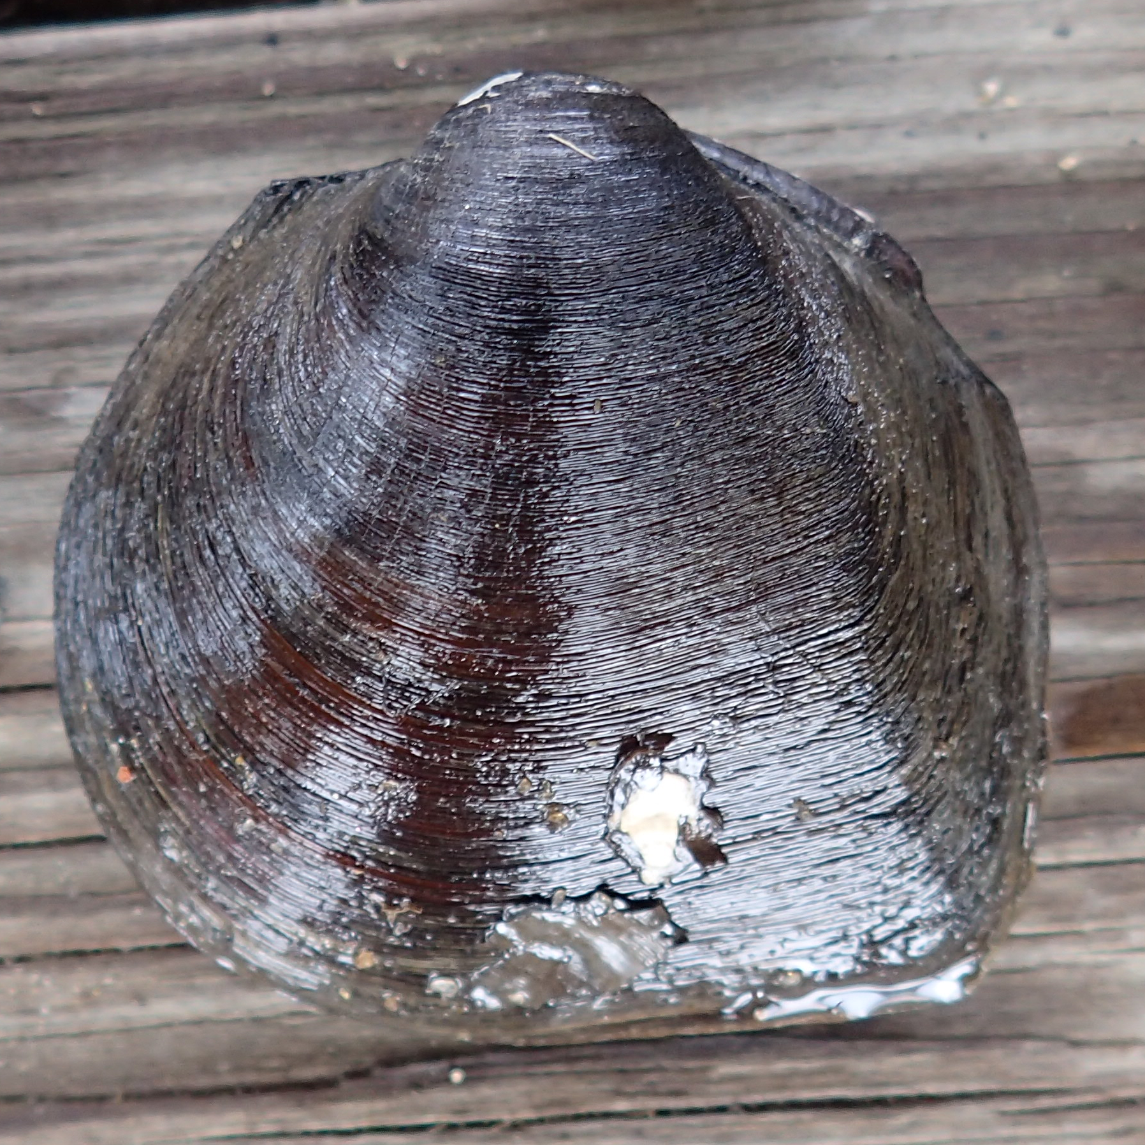
Introduction
Fusconaia escambia – Federally Threatened
Assumed to live a more sedentary lifestyle
Response to stimuli may alter this behavior
Drawdown similar to drought effect
Tracking receding water observed among all species in Point A (2017) and Gantt (2019) Reservoir drawdown
Notes:
As Meet said, Gantt Reservoir is known to have the largest population of F.e – A fed threatened species. It is assumed to live a more sedentary lifestyle.
Drawdown similar to drought effect, or even much worse since this lake went down to 25 or 27ft. Nowadays, with climate change getting more and more severe overtime, we are facing more devastating drought. The mimicry of the drought and receding water initiated a question of are mussels tracking and moving to get access to water, or moisture? We knew that when were drawing down Point A, several USFWS persons and volunteers had observed mussel moving and tracking down water. So now we were drawing down Gantt Res, we are going to quantify their movement.

Slide 4
Objectives
Determine linear distance and direction F. escambia and Elliptio pullata are able to track receding water levels
Determine if F. escambia and E. pullata burrow in response to drawdown

Slide 5
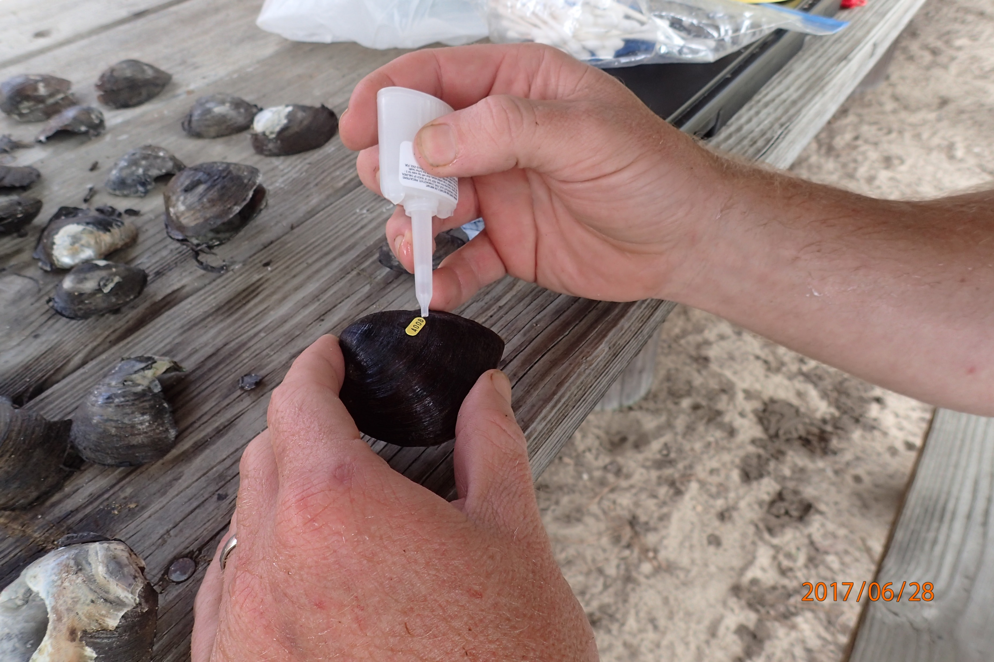
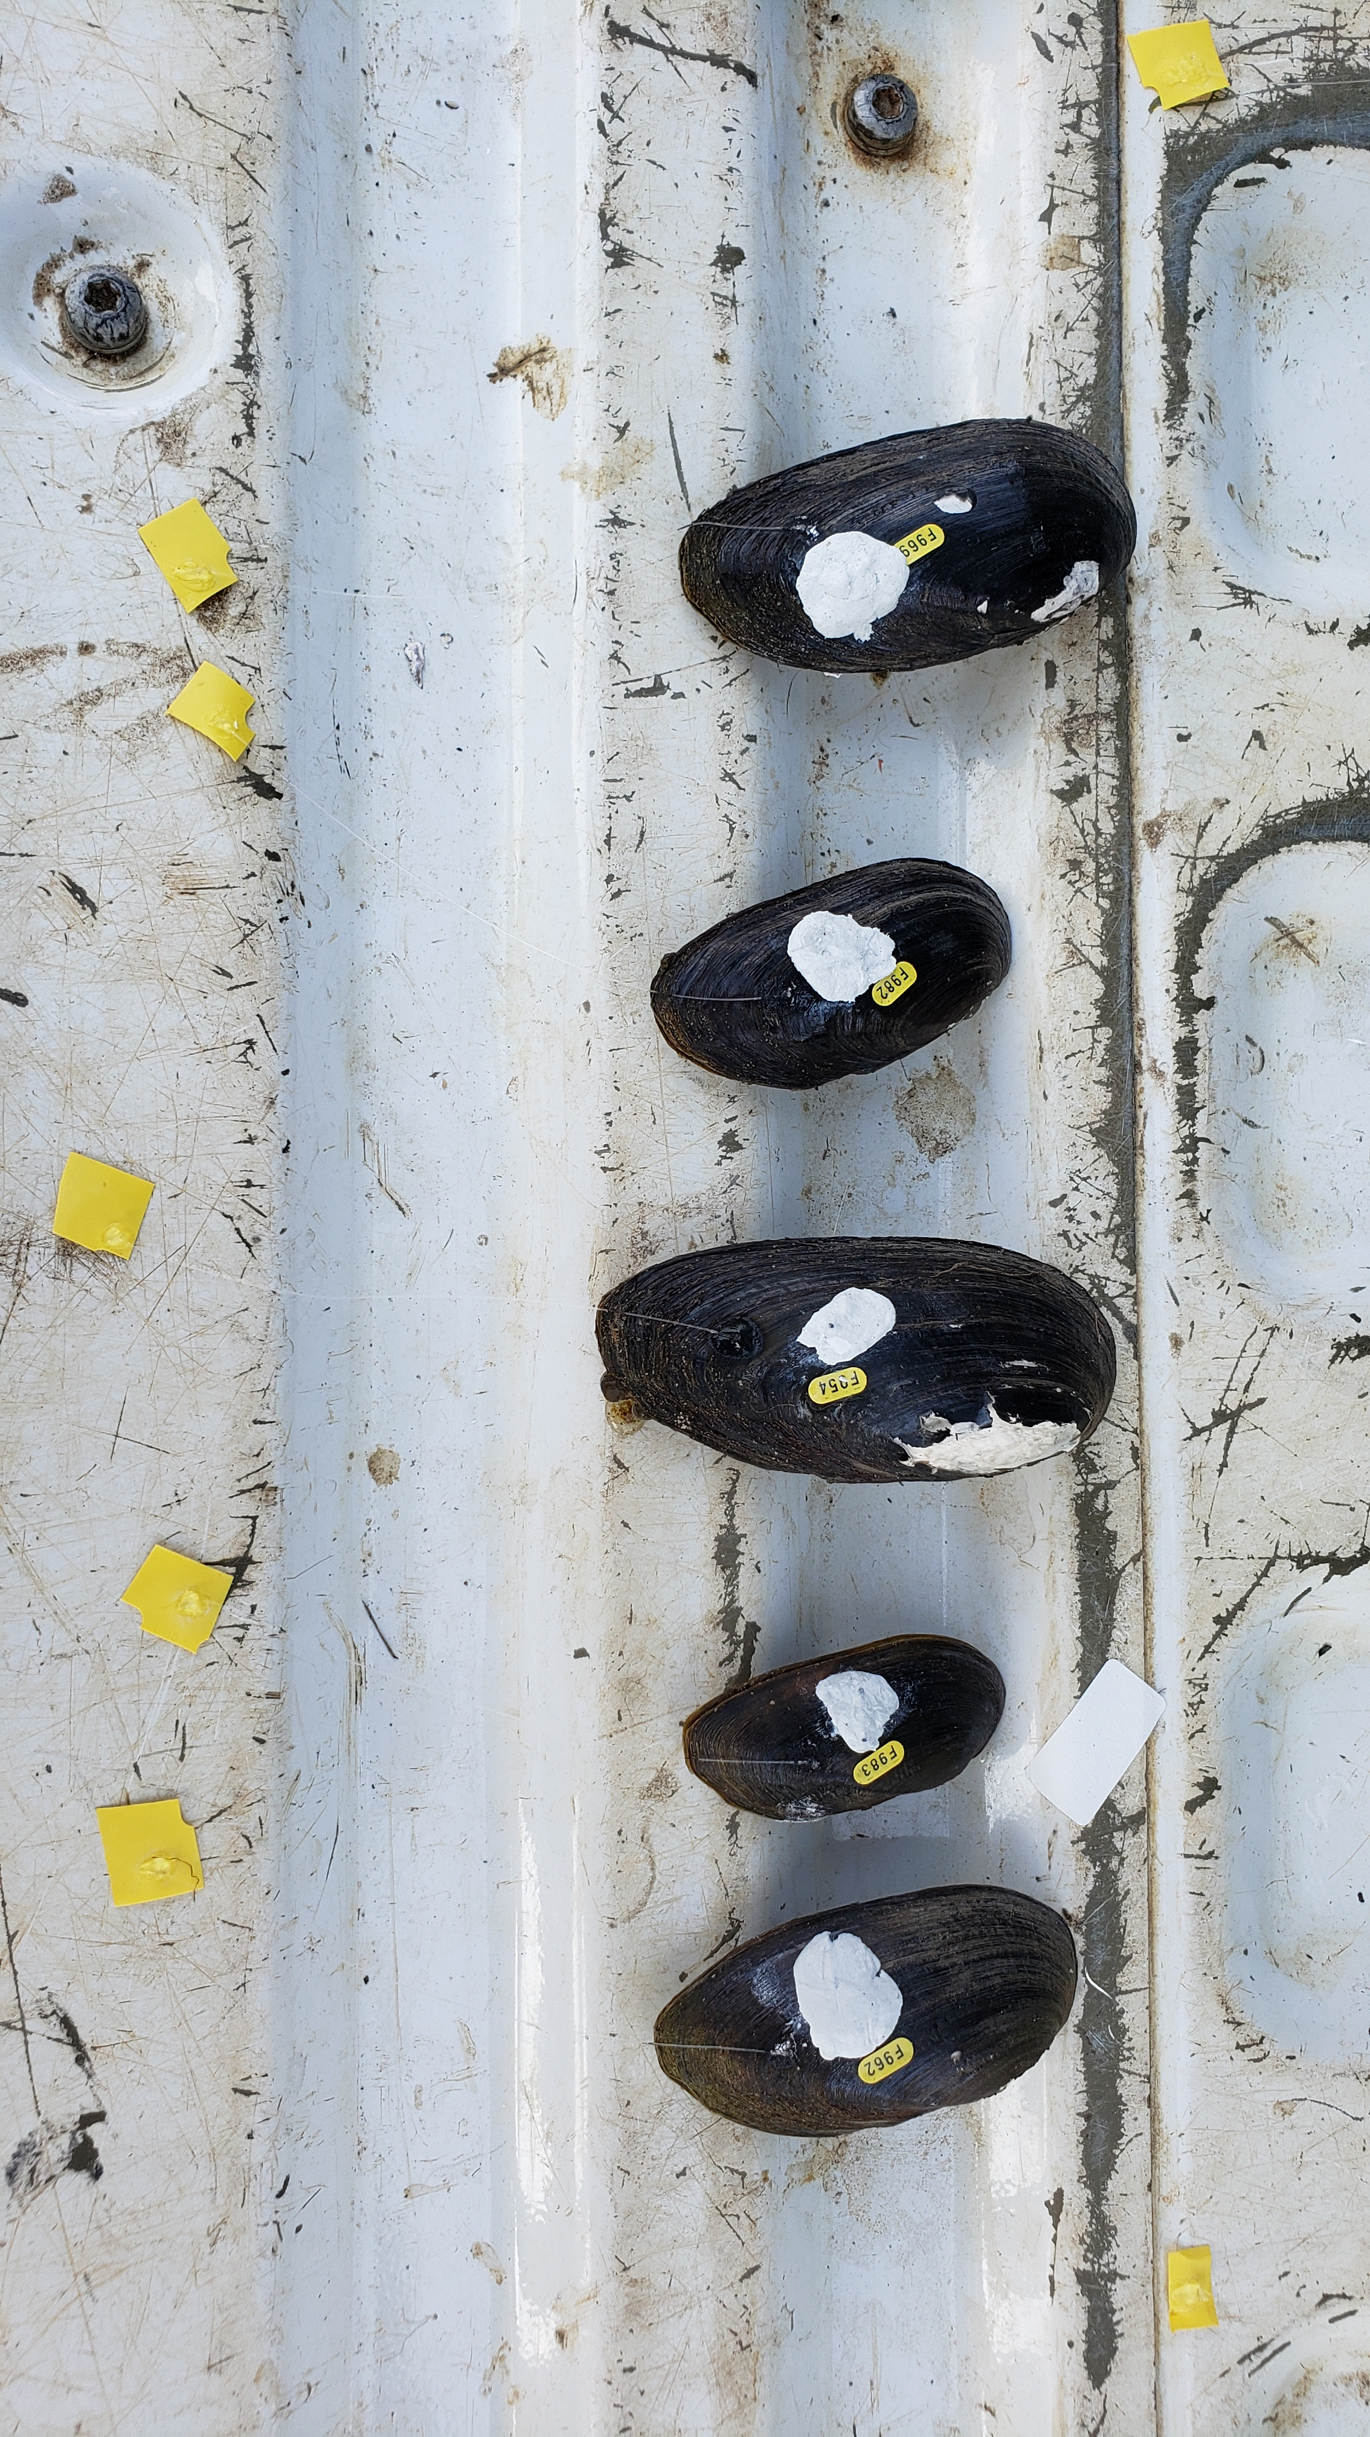
Methods
F. escambia and E. pullata
Eleven of each species collected about 2 weeks prior to drawdown
Each uniquely tagged:
Hallprint
Biomark PIT tag
10 cm monofilament attached and tagged
Used to determine depth
Each individual placed parallel to bank at about 2 ft depth and spaced about 1 m apart

Slide 6
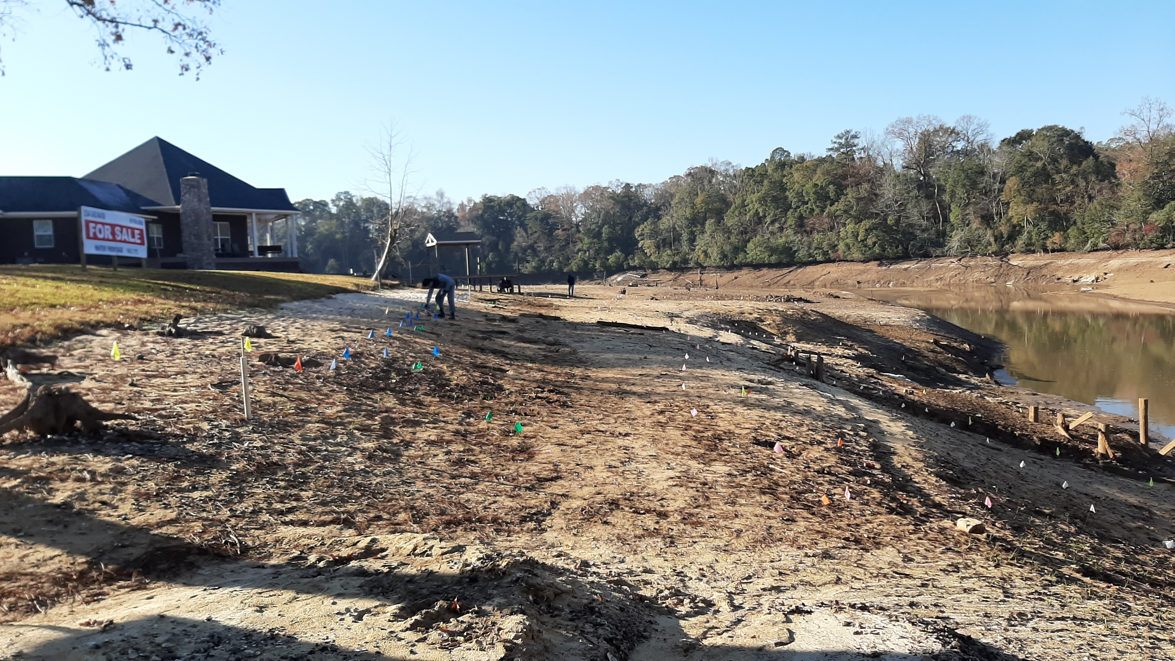
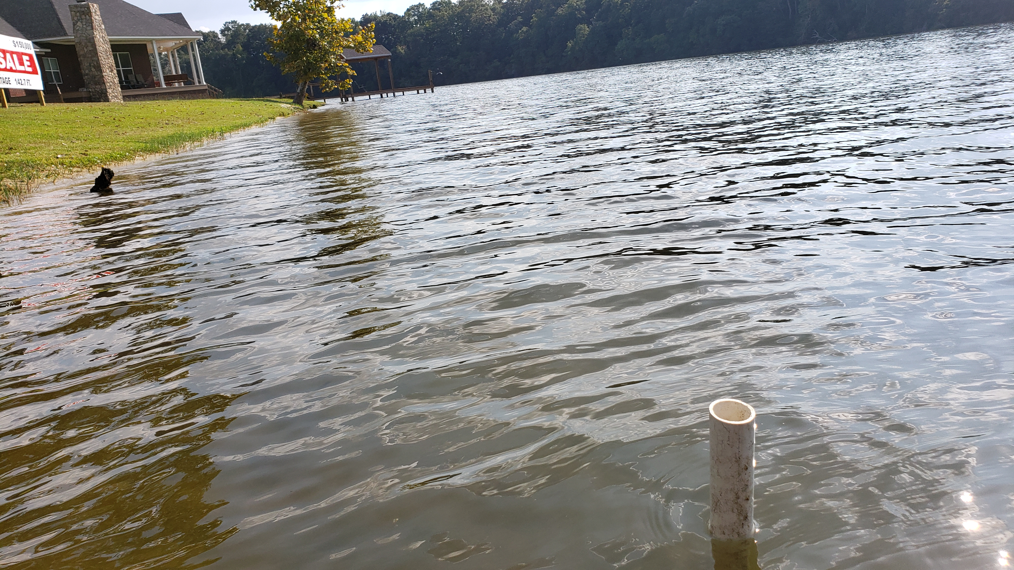
Methods
Determine final locations of mussels
About two weeks after drawdown initiated
Distance from original location & depth (or exposed)
Destron Fearing Portable Transceiver System 2001F-ISO
Notes:
After two weeks …, we determine … => the reason being was to wait for the surface and the substrate to be dried out and hardened so that, first, the condition wouldn’t allow the mussels to move anymore, and second, we are not going to destroy our study area.

Slide 7
Results
F. escambia
E. pullata
Tag # | Measurement (cm) | Exposure | Direction
F930 | 85 | exposed | DH
F931 | 31 | exposed | DH
F932 | 0 | exposed | -
F933 | 0 | exposed | -
F929 | 193 | ~1 cm | DH
A008 | 189 | exposed | DH
A023 | 115 | ~1 cm | DH
A010 | 156 | ~1 cm | DH
1762 | 124 | ~1 cm | DH
A047 | 175 | ~1 cm | DH
A092 | 126 | ~1 cm | DH
Min | 0 | 5 exposed
Max | 193
Mean | 108.5 | 6 burrow
Median | 124
Tag # | Measurement (cm) | Exposure | Direction
F962 | 130 | exposed | DH
F966 | 0 | ~1 cm | -
F969 | 35 | exposed | DH
F979 | 0 | ~1 cm | -
F980 | 106 | ~1 cm | DH
F982 | 95 | ~1 cm | DH
F983 | 158 | exposed | DH
F954 | 226 | ~1 cm | DH
F958 | 0 | exposed | -
F970 | 20 | ~1 cm | DH
F977 | 0 | ~1 cm | -
Min | 0 | 4 exposed
Max | 226
Mean | 70 | 7 burrow
Median | 35
No measurable deviation from downhill movement (US or DS direction)
F. escambia was better at tracking receding water, although sample size was small and study occurred in a reservoir habitat
Notes:
Both species were able to track and burrow, as we can see in the table. However, …

Slide 8
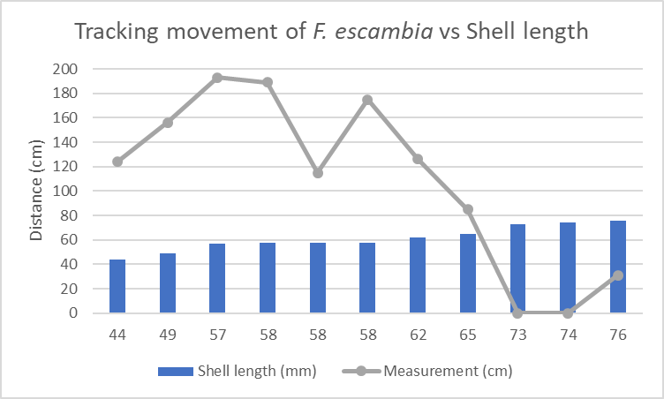
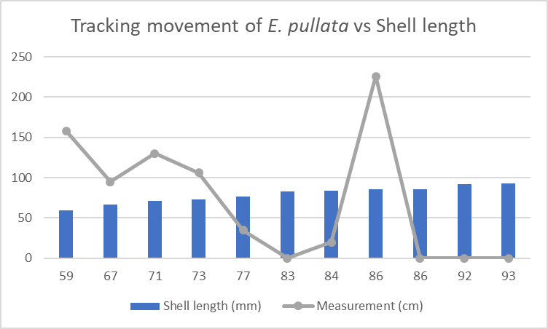
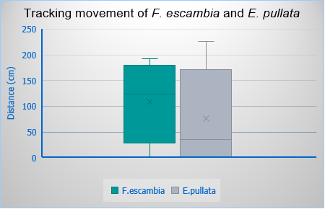
Results
F. escambia movement was less skewed and had less outliers compared to E. pullata
F. escambia and E. pullata movement generally showed a negative relationship with their shell length
Welch two-sample t-test – no significant difference (p = 0.24)

Slide 9
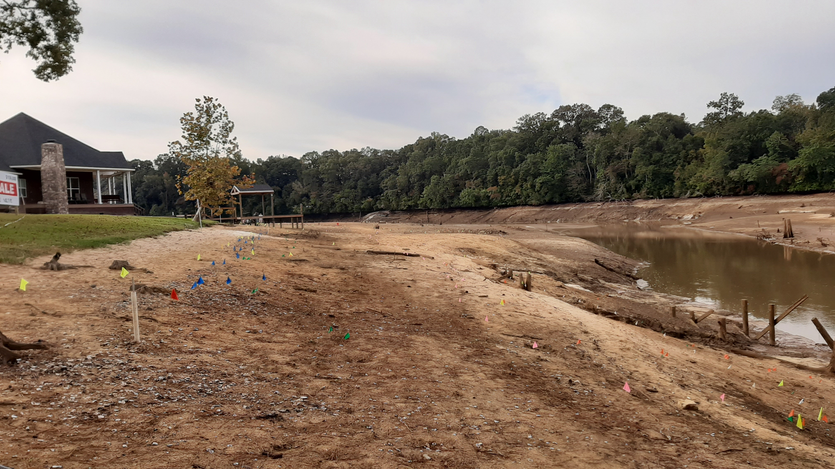
Discussion
Bank angle rather steep (slope not measured) but generally similar to mussel habitat on fringes of stream banks
Comparable to stream conditions?
Disclosures
Lake drained fast – droughts more subtle in receding water levels
Stayed dry for 13 weeks
Sediment not favorable for movement once dried to certain extent (beyond soupy mess) – >1 week
No flow may have altered movement responses
Only downhill recorded – no US or DS movement

Slide 10
Discussion
Under stream condition scenarios, many individuals may have been able to track receding water and survive (intolerant) (Gough et al. 2012)
All mussels moved downhill (tracking receding water), rather than showing variation or random movement
Higher slope may have increased survival of mussels (Newton et al. 2014)
Notes:
highly sloped surfaces might cue
directional movement of mussels and provide easier
access to deeper water than unsloped surfaces.

Slide 11
Acknowledgements
Dr. James Stoeckel (Auburn University)
Dr. Brian Helms and Mr. Daniel Isenberg (Troy University)
References
Gough, H. M., Landis, A. M. G., Stoeckel, J. A., 2012. Behaviour and physiology are linked in the responses of freshwater mussels to drought. Freshwater Biology 57(11), 2356–2366. doi: 10.1111/fwb.12015
Newton, T. J., Zigler, S. J., Gray, B. R., 2014. Mortality, movement and behaviour of native mussels during a planned water-level drawdown in the Upper Mississippi River. Freshwater Biology 60(1), 1–15. doi: 10.1111/fwb.12461

Slide 12
Questions?

